Slide 1
Week 6

Slide 2
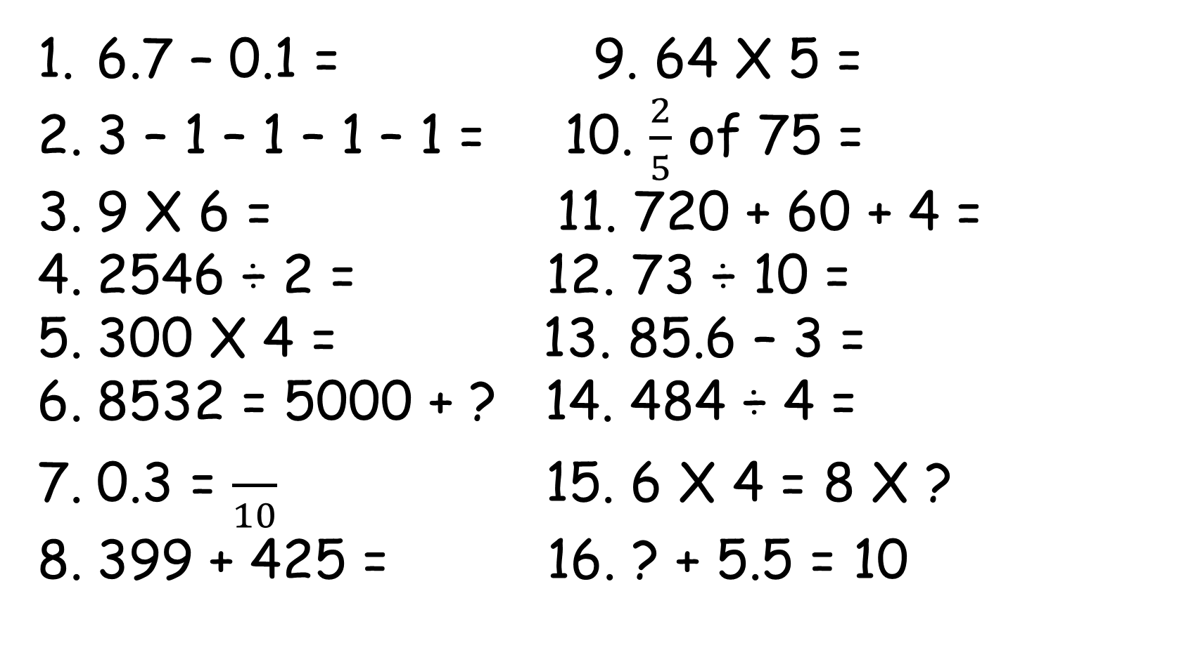
Monday - 30.3.2020
6.7 – 0.1 = 9. 64 X 5 =
3 – 1 – 1 – 1 – 1 = 10. $\frac{2}{5}$ of 75 =
9 X 6 = 11. 720 + 60 + 4 =
2546 ÷ 2 = 12. 73 ÷ 10 =
300 X 4 = 13. 85.6 – 3 =
8532 = 5000 + ? 14. 484 ÷ 4 =
0.3 = $\frac{}{10}$ 15. 6 X 4 = 8 X ?
399 + 425 = 16. ? + 5.5 = 10

Slide 3
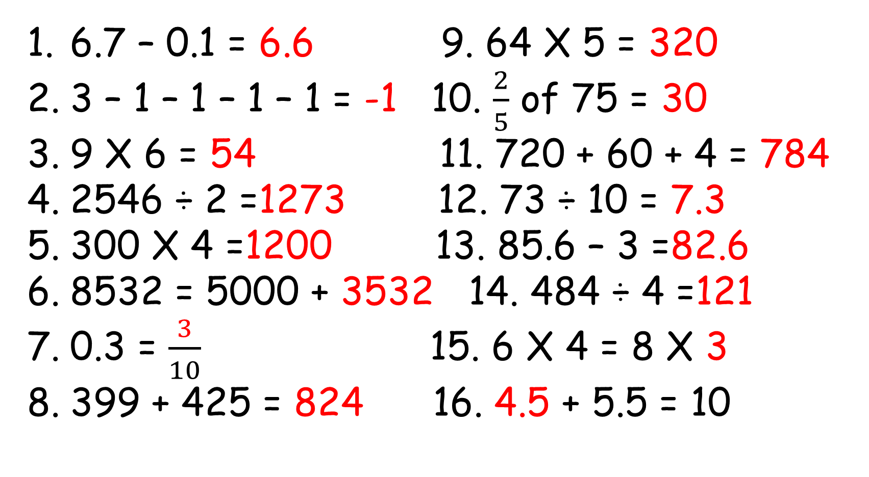
Monday - 30.3.2020
6.7 – 0.1 = 6.6 9. 64 X 5 = 320
3 – 1 – 1 – 1 – 1 = -1 10. $\frac{2}{5}$ of 75 = 30
9 X 6 = 54 11. 720 + 60 + 4 = 784
2546 ÷ 2 =1273 12. 73 ÷ 10 = 7.3
300 X 4 =1200 13. 85.6 – 3 =82.6
8532 = 5000 + 3532 14. 484 ÷ 4 =121
0.3 = $\frac{3}{10}$ 15. 6 X 4 = 8 X 3
399 + 425 = 824 16. 4.5 + 5.5 = 10

Slide 4
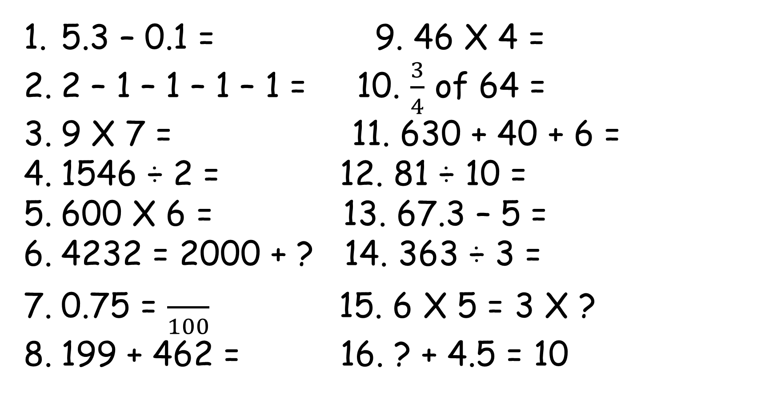
Tuesday - 31.3.2020
5.3 – 0.1 = 9. 46 X 4 =
2 – 1 – 1 – 1 – 1 = 10. $\frac{3}{4}$ of 64 =
9 X 7 = 11. 630 + 40 + 6 =
1546 ÷ 2 = 12. 81 ÷ 10 =
600 X 6 = 13. 67.3 – 5 =
4232 = 2000 + ? 14. 363 ÷ 3 =
0.75 = $\frac{}{100}$ 15. 6 X 5 = 3 X ?
199 + 462 = 16. ? + 4.5 = 10

Slide 5
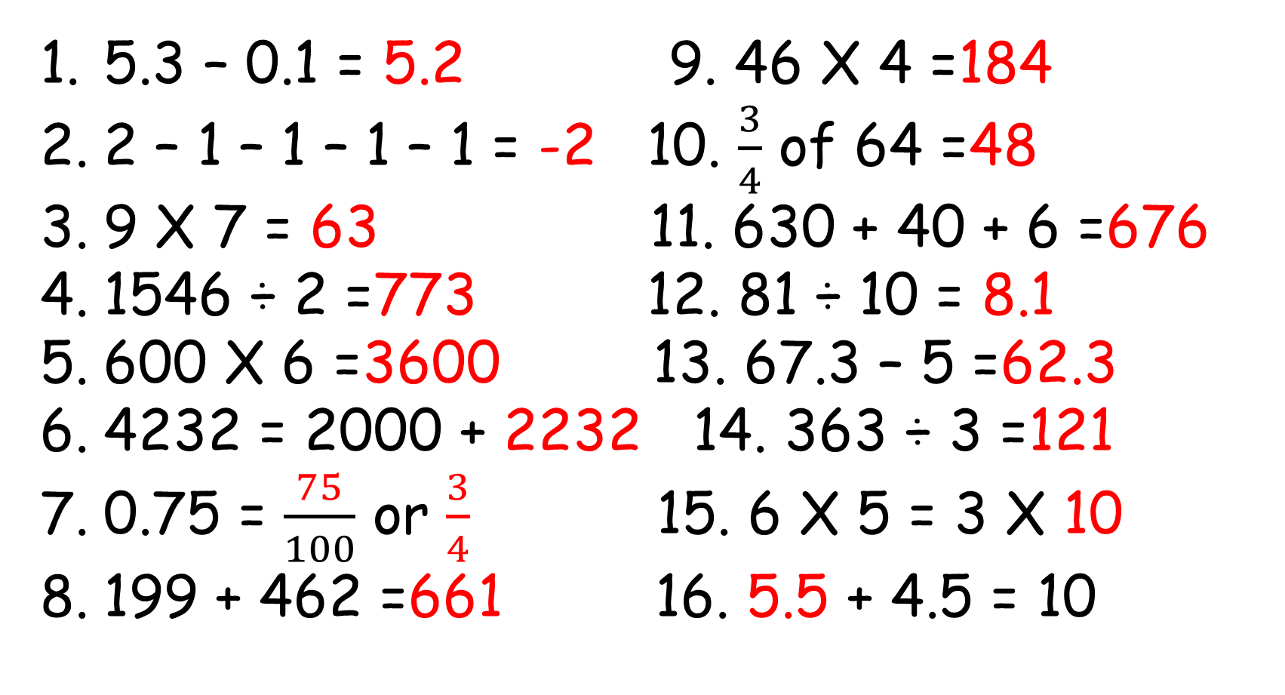
Tuesday - 31.3.2020
5.3 – 0.1 = 5.2 9. 46 X 4 =184
2 – 1 – 1 – 1 – 1 = -2 10. $\frac{3}{4}$ of 64 =48
9 X 7 = 63 11. 630 + 40 + 6 =676
1546 ÷ 2 =773 12. 81 ÷ 10 = 8.1
600 X 6 =3600 13. 67.3 – 5 =62.3
4232 = 2000 + 2232 14. 363 ÷ 3 =121
0.75 = $\frac{75}{100}$ or $\frac{3}{4}$ 15. 6 X 5 = 3 X 10
199 + 462 =661 16. 5.5 + 4.5 = 10

Slide 6
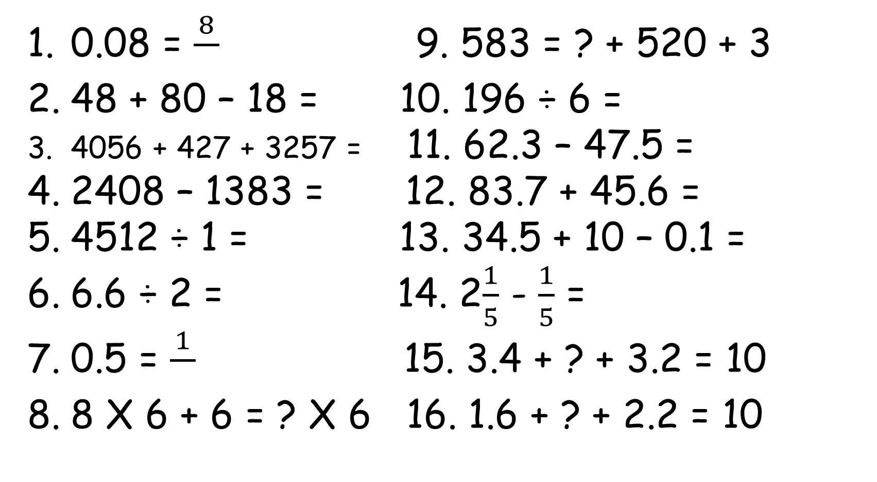
Wednesday - 1.4.2020
0.08 = $\frac{8}{}$ 9. 583 = ? + 520 + 3
48 + 80 – 18 = 10. 196 ÷ 6 =
4056 + 427 + 3257 = 11. 62.3 – 47.5 =
2408 – 1383 = 12. 83.7 + 45.6 =
4512 ÷ 1 = 13. 34.5 + 10 – 0.1 =
6.6 ÷ 2 = 14. 2$\frac{1}{5}$ - $\frac{1}{5}$ =
0.5 = $\frac{1}{}$ 15. 3.4 + ? + 3.2 = 10
8 X 6 + 6 = ? X 6 16. 1.6 + ? + 2.2 = 10

Slide 7
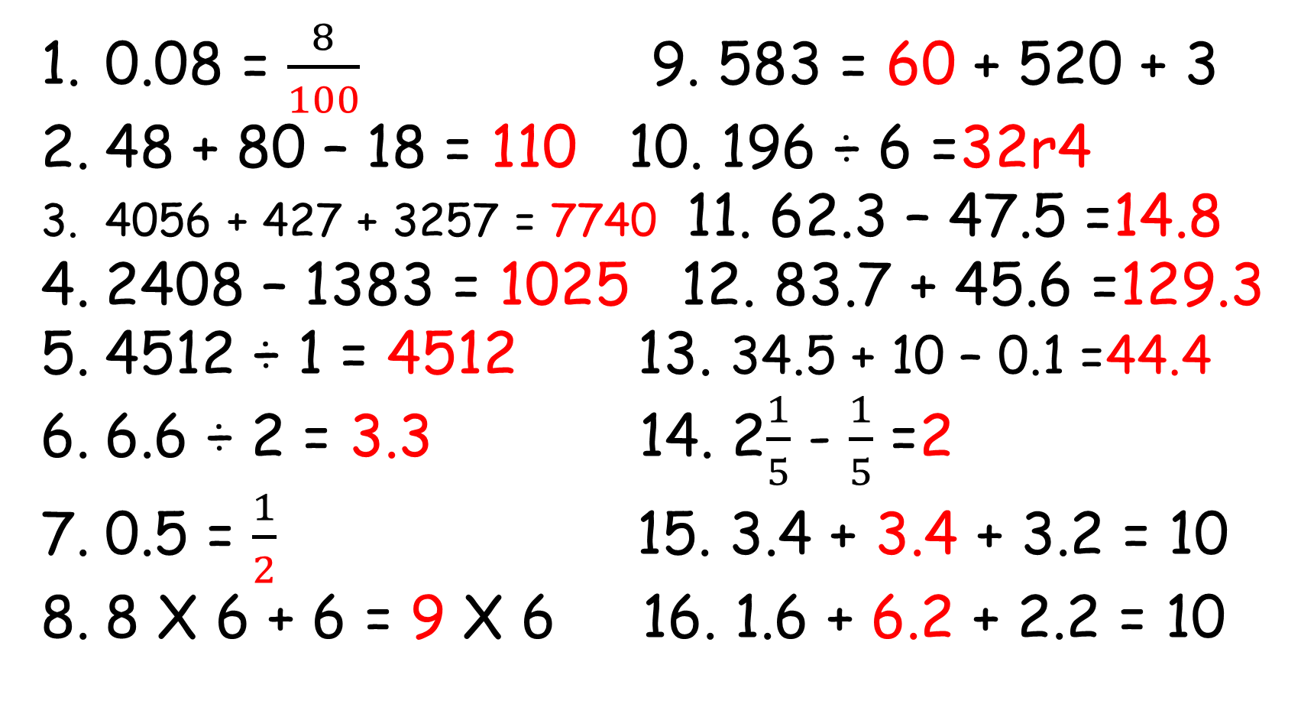
Wednesday - 1.4.2020
0.08 = $\frac{8}{100}$ 9. 583 = 60 + 520 + 3
48 + 80 – 18 = 110 10. 196 ÷ 6 =32r4
4056 + 427 + 3257 = 7740 11. 62.3 – 47.5 =14.8
2408 – 1383 = 1025 12. 83.7 + 45.6 =129.3
4512 ÷ 1 = 4512 13. 34.5 + 10 – 0.1 =44.4
6.6 ÷ 2 = 3.3 14. 2$\frac{1}{5}$ - $\frac{1}{5}$ =2
0.5 = $\frac{1}{2}$ 15. 3.4 + 3.4 + 3.2 = 10
8 X 6 + 6 = 9 X 6 16. 1.6 + 6.2 + 2.2 = 10

Slide 8
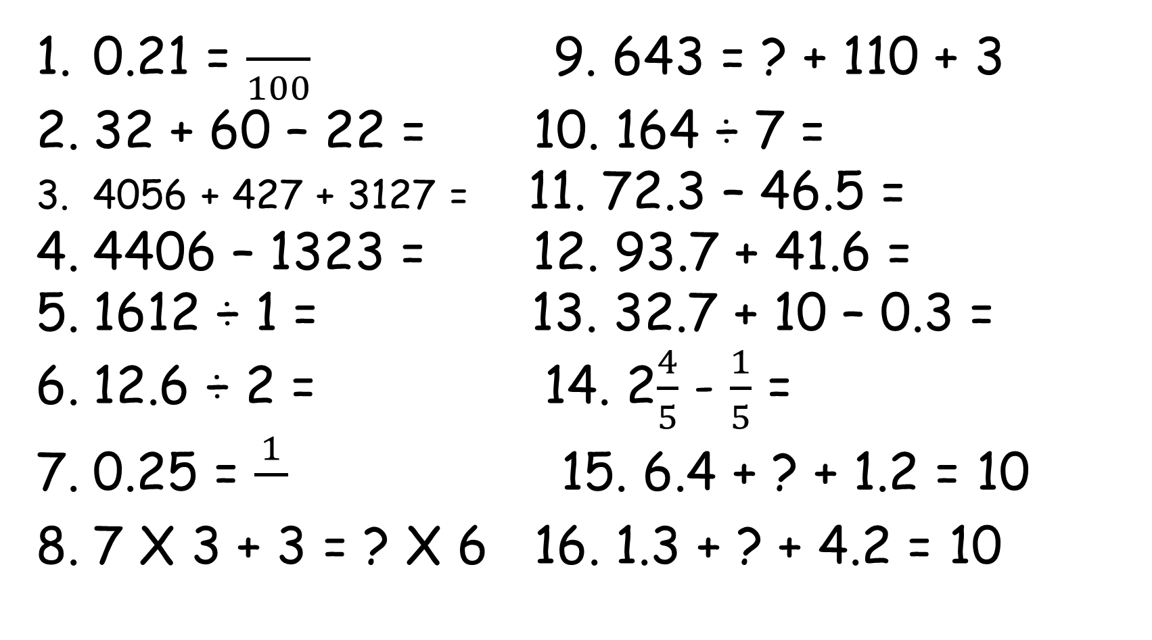
Thursday - 2.4.2020
0.21 = $\frac{}{100}$ 9. 643 = ? + 110 + 3
32 + 60 – 22 = 10. 164 ÷ 7 =
4056 + 427 + 3127 = 11. 72.3 – 46.5 =
4406 – 1323 = 12. 93.7 + 41.6 =
1612 ÷ 1 = 13. 32.7 + 10 – 0.3 =
12.6 ÷ 2 = 14. 2$\frac{4}{5}$ - $\frac{1}{5}$ =
0.25 = $\frac{1}{}$ 15. 6.4 + ? + 1.2 = 10
7 X 3 + 3 = ? X 6 16. 1.3 + ? + 4.2 = 10

Slide 9
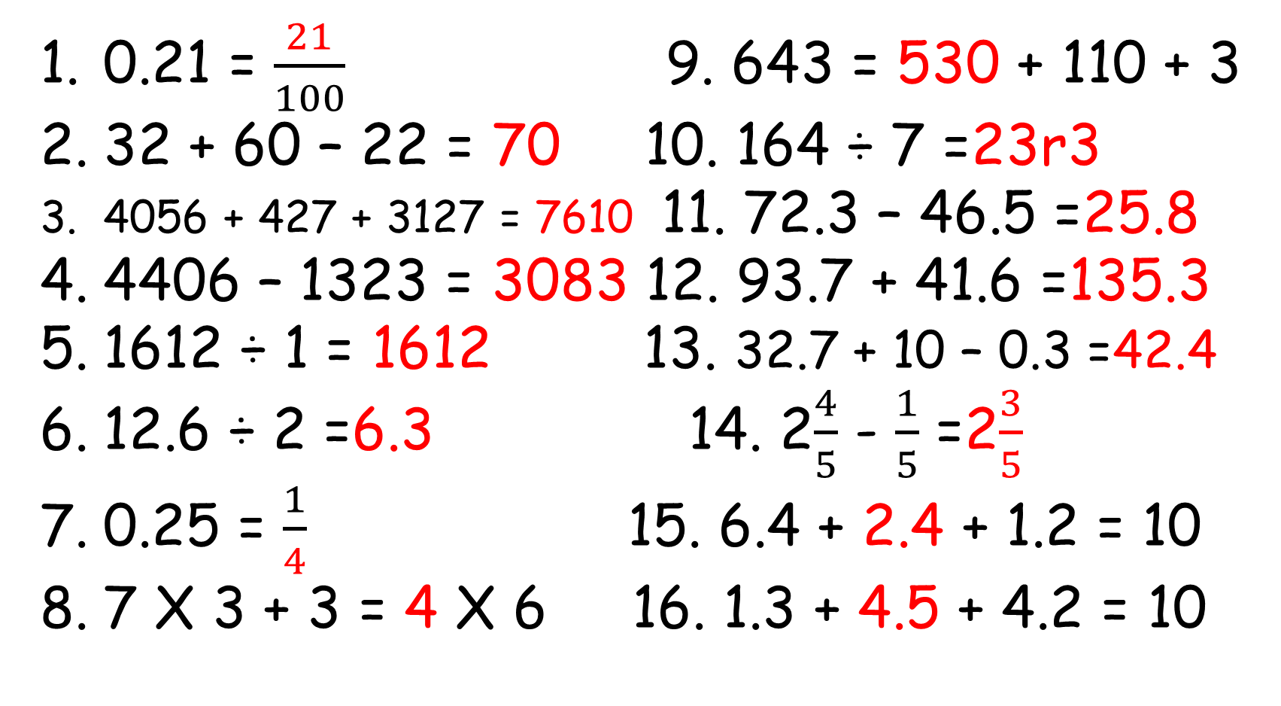
Thursday - 2.4.2020
0.21 = $\frac{21}{100}$ 9. 643 = 530 + 110 + 3
32 + 60 – 22 = 70 10. 164 ÷ 7 =23r3
4056 + 427 + 3127 = 7610 11. 72.3 – 46.5 =25.8
4406 – 1323 = 3083 12. 93.7 + 41.6 =135.3
1612 ÷ 1 = 1612 13. 32.7 + 10 – 0.3 =42.4
12.6 ÷ 2 =6.3 14. 2$\frac{4}{5}$ - $\frac{1}{5}$ =2$\frac{3}{5}$
0.25 = $\frac{1}{4}$ 15. 6.4 + 2.4 + 1.2 = 10
7 X 3 + 3 = 4 X 6 16. 1.3 + 4.5 + 4.2 = 10

Slide 10
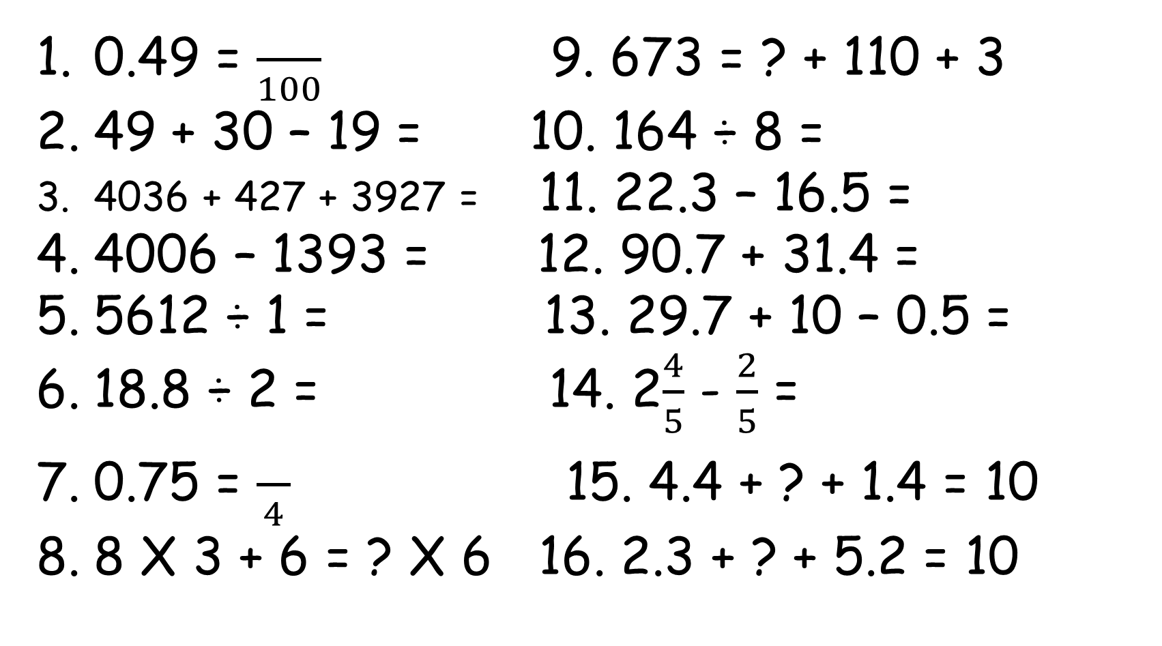
Friday - 3.4.2020
0.49 = $\frac{}{100}$ 9. 673 = ? + 110 + 3
49 + 30 – 19 = 10. 164 ÷ 8 =
4036 + 427 + 3927 = 11. 22.3 – 16.5 =
4006 – 1393 = 12. 90.7 + 31.4 =
5612 ÷ 1 = 13. 29.7 + 10 – 0.5 =
18.8 ÷ 2 = 14. 2$\frac{4}{5}$ - $\frac{2}{5}$ =
0.75 = $\frac{}{4}$ 15. 4.4 + ? + 1.4 = 10
8 X 3 + 6 = ? X 6 16. 2.3 + ? + 5.2 = 10

Slide 11
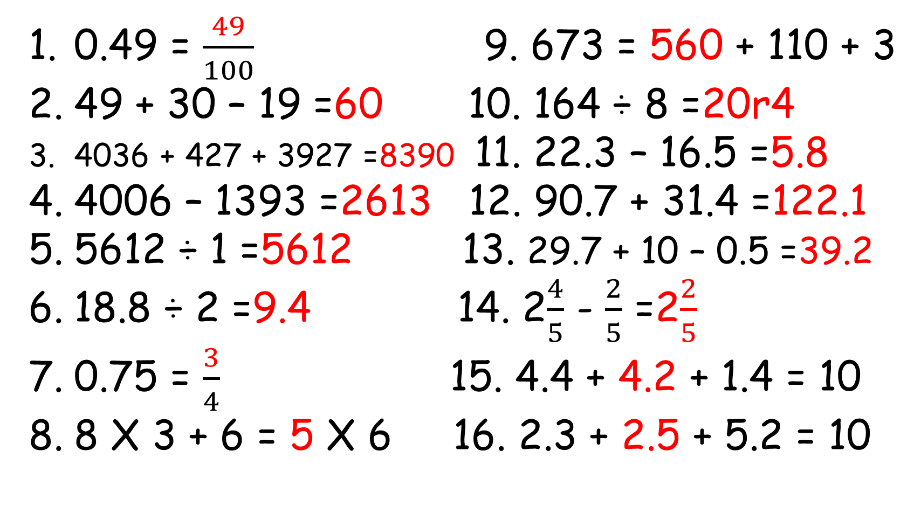
Friday - 3.4.2020
0.49 = $\frac{49}{100}$ 9. 673 = 560 + 110 + 3
49 + 30 – 19 =60 10. 164 ÷ 8 =20r4
4036 + 427 + 3927 =8390 11. 22.3 – 16.5 =5.8
4006 – 1393 =2613 12. 90.7 + 31.4 =122.1
5612 ÷ 1 =5612 13. 29.7 + 10 – 0.5 =39.2
18.8 ÷ 2 =9.4 14. 2$\frac{4}{5}$ - $\frac{2}{5}$ =2$\frac{2}{5}$
0.75 = $\frac{3}{4}$ 15. 4.4 + 4.2 + 1.4 = 10
8 X 3 + 6 = 5 X 6 16. 2.3 + 2.5 + 5.2 = 10

